Slide 1
ANALYSIS OF LAPTOP PRICES DATASET
ALY6015 INTERMEDIATE ANALYTICS
PROF. MYKHAYLO TRUBSKYY
BY:
VAIBHAV SALONIA
HRITHICK GOKUL YEDDULA
ANBIRKINIAN KANNAN

Slide 2
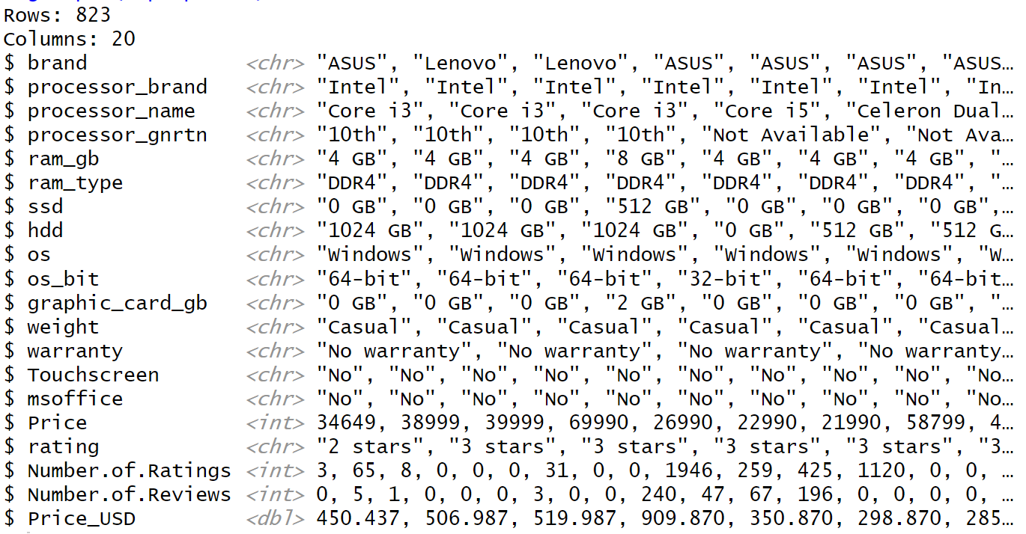
INTRODUCTION
In today's digitized world, computers are essential across various sectors. Laptops, offering portability and convenience, have become indispensable. This analysis explores diverse laptop models, focusing on brands like ASUS, Lenovo, Acer, and Avita. The dataset includes detailed specifications, prices, and market positions, providing valuable insights.
Glimpse of the Dataset

Slide 3
METHODS
This investigation used two methods: multiple linear regression and cluster analysis.
Multiple Linear Regression: A method for analysing the relationship between multiple independent factors (e.g., processor specifications, RAM capacity, storage options) and a continuous dependent variable (price). This helps us understand how changes in the independent variables affect laptop prices.
Cluster Analysis: A method for identifying groups or clusters within a dataset based on the similarity of observations. This helps to group similar computers together based on their specifications, enabling for the identification of market niches with distinct pricing characteristics.
There are few questions that we are looking to answer from our analysis.

Slide 4
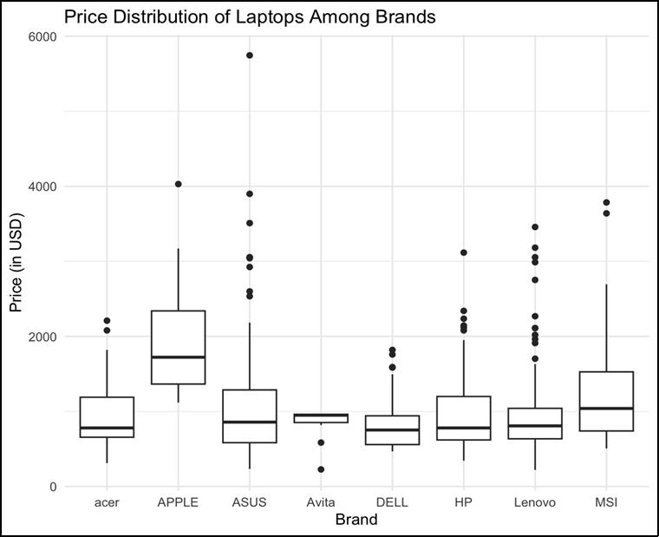
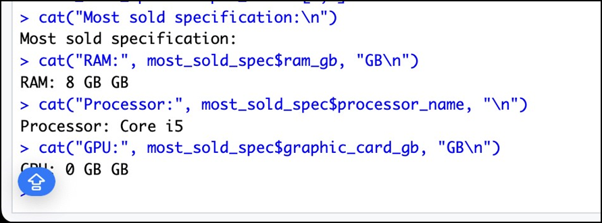
Question 1: What is the price distribution among brands?
Answer: The box plot depicts pricing on the y-axis and brand names on the x-axis. The box plot is useful for visualising outliers, such as very high and low prices. For example, ASUS has a laptop with the highest price, which is significantly higher than the typical laptop price.
Question 2: What are the most sold specifications in laptops?
Answer: The most popular processor is the Core i5, the most common RAM is 8GB, and most laptops lack specialised graphics units. These standards are primarily sold for office and educational uses.

Slide 5
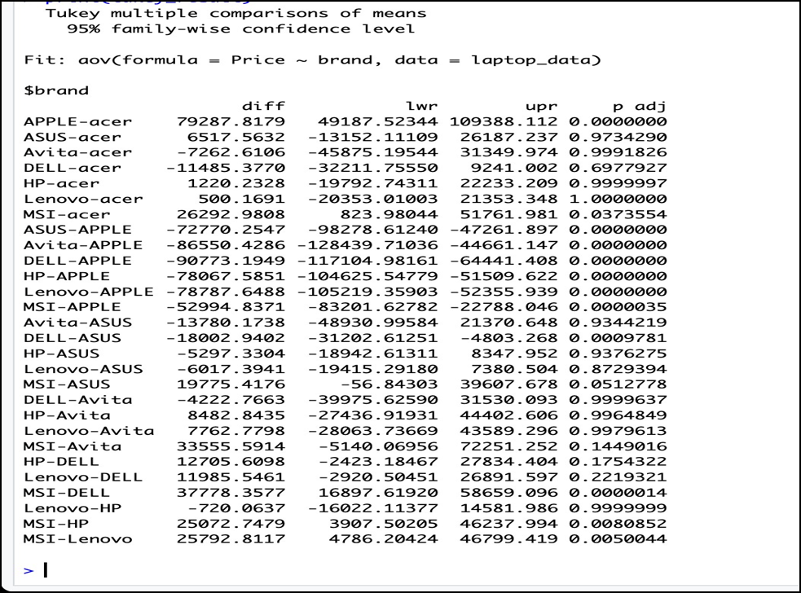
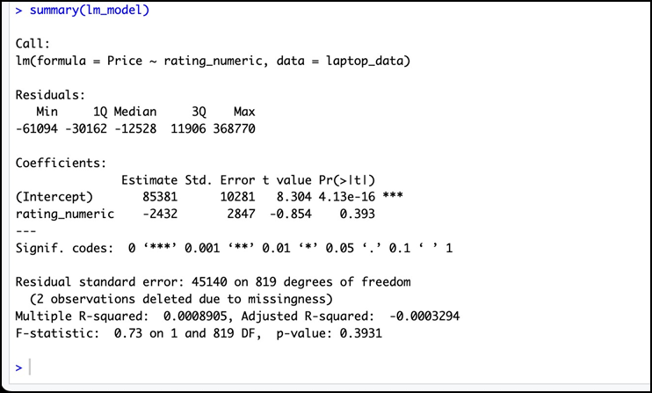
Question 3: Does the brand have an impact on the price?
Answer: ANOVA test findings indicate that the brand price influences the laptop pricing. The Tukey HSD test identifies specific pairings of brands that differ significantly in terms of mean prices.
Question 4: Does user rating change the price of the product?
Answer: The linear regression model for user rating and price revealed no significant linear relationships. The coefficient for user rating was not statistically significant, showing that user rating had no meaningful effect on laptop price.

Slide 6
Question 5: Multiple Linear Regression
Answer: In multiple linear regression, categorical values were transformed into factors. The investigation sought to determine whether ratings have a linear association with laptop prices. The results revealed that there was no statistically significant linear association between the rating and laptop prices.
Question 6: Cluster Analysis
Answer: Cluster analysis was performed to categorise similar computers based on specifications. This helps define market segments with various pricing characteristics depending on processor specifications, RAM capacity, storage options, and so on.

Slide 7
CONCLUSION
The analysis of the laptop price dataset revealed significant findings. Brand pricing varied widely, with some brands commanding higher prices. The most popular configurations featured 4GB RAM, Core i3 processors, and no dedicated graphics cards. User ratings correlated with higher prices. The adjusted R-squared of 59.5% indicates the model's significance. Recommendations include focusing on popular configurations and utilizing brand positioning for pricing strategies.
References:
Goyal, A. (2023, May 7). Laptop prices dataset. Kaggle.
https://www.kaggle.com/datasets/anubhavgoyal10/laptop-prices-dataset
Ie. “Using the R-Squared Statistic in ANOVA and General Linear Models.” Implementation, 25 Apr. 2019, www.implementation.com/using-the-r-squared-statistic-in-anova-and-general-linear-models/.

